Slide 1

Cruise Control System of a Vehicle
JEEVA S
Notes:
• Cruise control is a convenient feature that allows drivers to maintain a consistent speed without constantly pressing the accelerator pedal. • This image depicts a serene driving scene, with a modern car cruising along a scenic highway at sunset. The driver's hand rests comfortably on the steering wheel, conveying a sense of relaxation and control. • Cruise control can help reduce driver fatigue on long journeys, improve fuel efficiency, and provide a more comfortable driving experience. • It's important to note that cruise control should be used with caution, as it may not be appropriate in all driving conditions, such as heavy traffic or winding roads. • Emphasize the benefits of cruise control, such as improved fuel economy, reduced driver fatigue, and a more relaxed driving experience. • Encourage the audience to consider the advantages of incorporating cruise control technology into their vehicles.

Slide 2
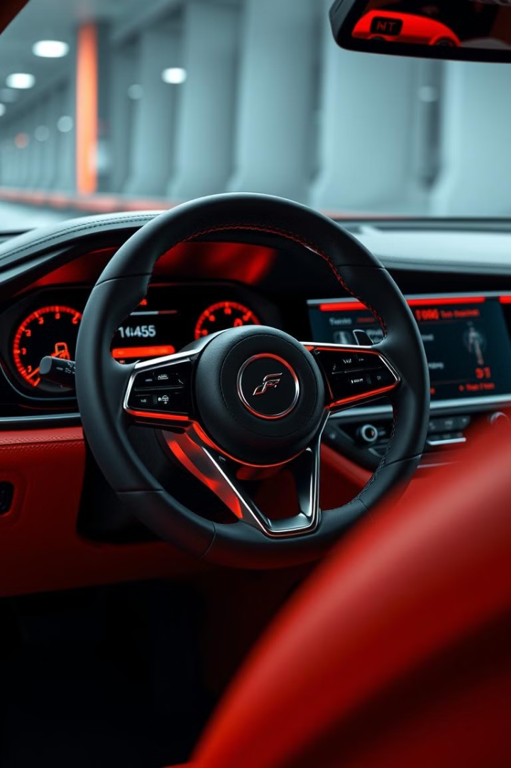
Abstract for Cruise Control System of a Vehicle
This presentation provides an in-depth overview of the cruise control system in modern vehicles. It explores the key components, working principles, and benefits of this advanced technology that enhances driving comfort and efficiency.

Slide 3
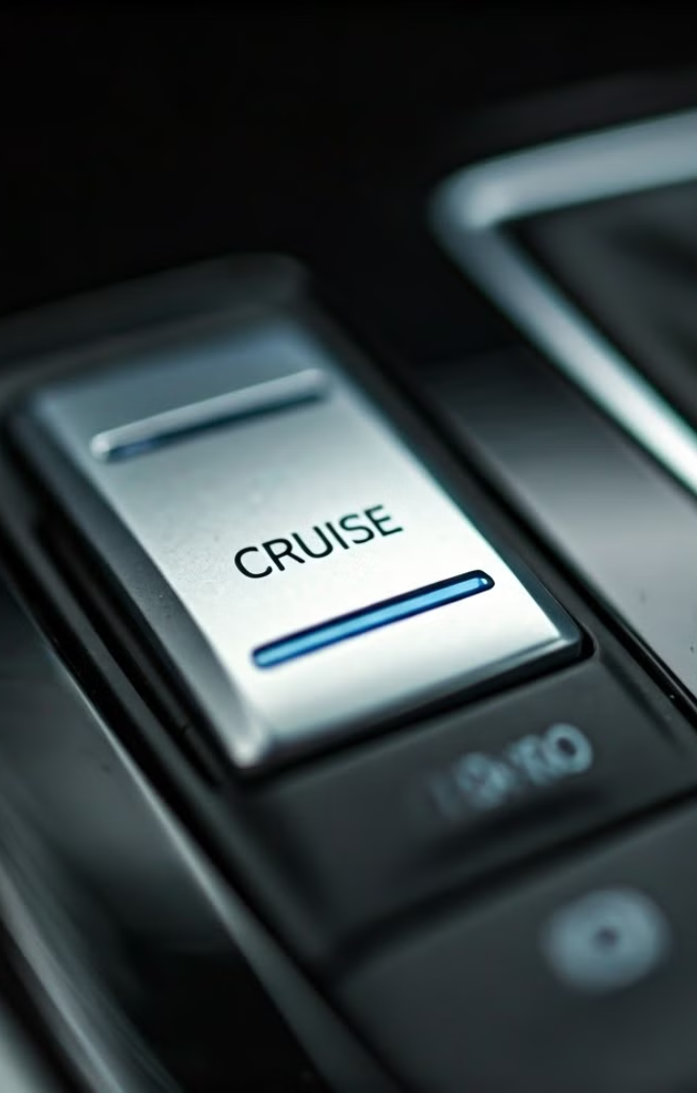
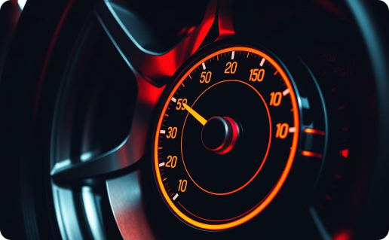

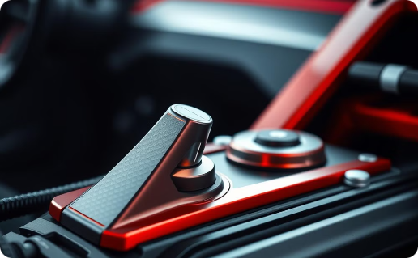
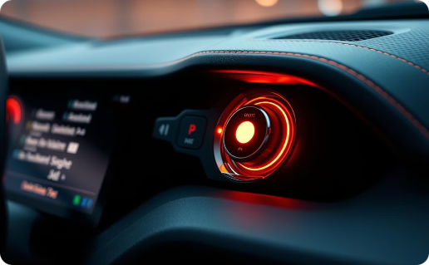
Block diagram of Cruise Control System
1.Speed Sensor
2.Control Unit
Measures vehicle speed and sends data to the control unit.
Processes speed data and adjusts throttle.
3.Actuator
4.User Interface
Adjusts throttle based on control unit commands.
Allows driver to set, adjust, and disengage cruise control.

Slide 4
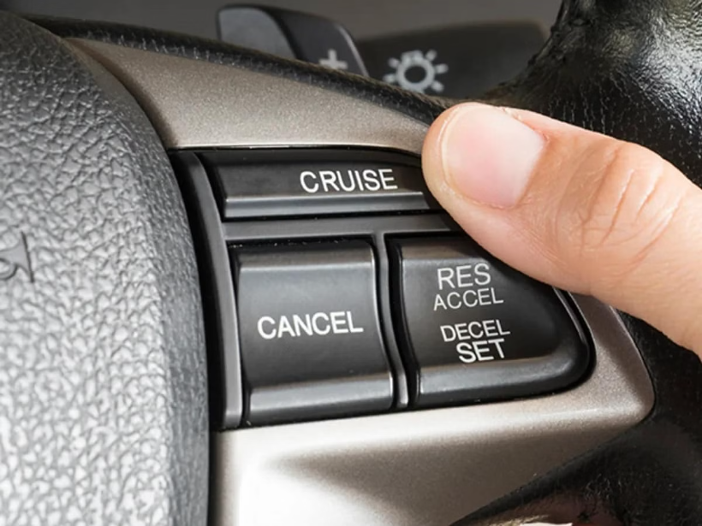
What is Cruise control?
Definition: Cruise control is an automated system that maintains a constant speed set by the driver.
The cruise control system is a valuable feature in modern vehicles, allowing drivers to maintain a constant speed without the need to continuously press the accelerator pedal.
The system takes over the throttle of the car to maintain a steady speed as set by the driver.
It is system that allows you to set your car to a specific speed, letting you take your foot off the accelerator pedal.
Cruise control - automatically controls the speed of a motor vehicle.
purpose: Enhances driver comfort during long-distance driving and improves fuel efficiency.

Slide 5
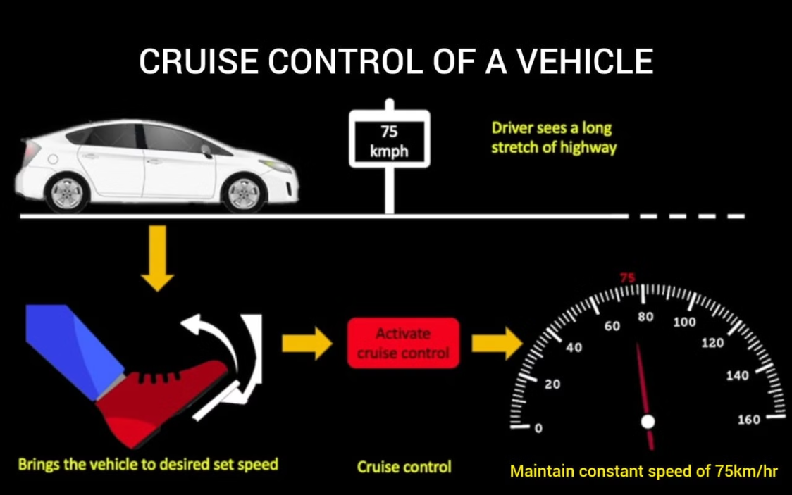

Slide 6
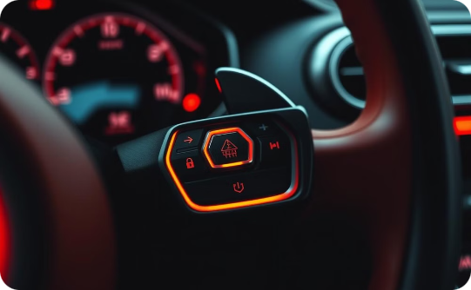
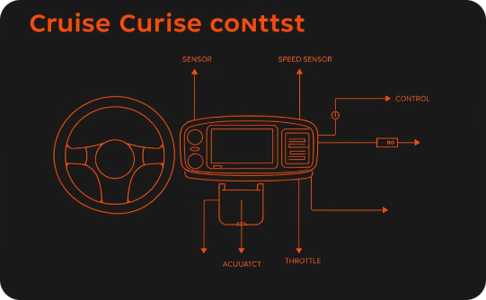
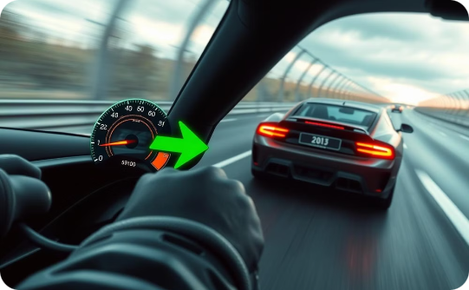
Cruise Control System
Cruise Control Buttons
System Components
Cruise Control in Action
The cruise control system is a valuable feature in modern vehicles, allowing drivers to maintain a constant speed without the need to continuously press the accelerator pedal.
This system uses various components, including a speed sensor, control unit, and actuator, to automatically adjust the throttle and maintain the desired speed set by the driver.
The speed sensor constantly monitors the vehicle's velocity and relays this information to the control unit. The control unit then processes the data and sends commands to the actuator, which in turn adjusts the throttle accordingly.

Slide 7
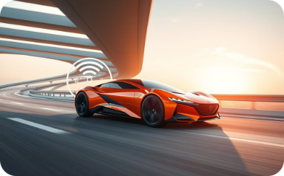
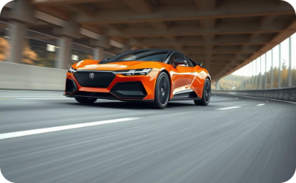
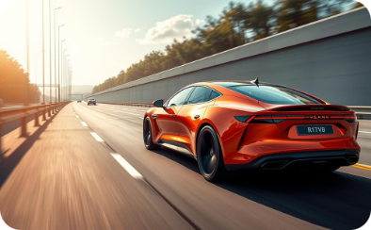

Adaptive Cruise Control
Radar, cameras, and sensors
Automatic acceleration and braking
Safe following distance
Reduced driver fatigue
Enhanced safety and convenience
Monitor the surrounding traffic
Maintain a constant speed and following distance
Adapt to changing road conditions
Adaptive cruise control (ACC) is an advanced cruise control system that automatically adjusts the vehicle's speed to maintain a safe following distance from the car ahead. This intelligent technology helps reduce driver fatigue and improves fuel efficiency by automatically maintaining a constant speed and following distance, even in stop-and-go traffic. It represents a significant step towards autonomous driving, enhancing safety and convenience for modern vehicles.

Slide 8
Application of Cruise Control System
Maintaining Constant Speed
Improved Fuel Economy
Reduced Fatigue
By keeping the vehicle at a steady speed, cruise control can help improve fuel efficiency and reduce fuel consumption.
Cruise control can help alleviate driver fatigue on long drives by automatically adjusting the vehicle's speed, allowing the driver to focus on the road ahead.
Cruise control allows drivers to maintain a consistent speed on highways, reducing the need for constant acceleration and braking.
Enhanced Safety
Adaptive Capabilities
Cruise control can help drivers maintain legal speed limits, reducing the risk of speeding and associated safety hazards.
Advanced cruise control systems, such as Adaptive Cruise Control (ACC), can automatically adjust the vehicle's speed to maintain a safe following distance from the car in front.

Slide 9
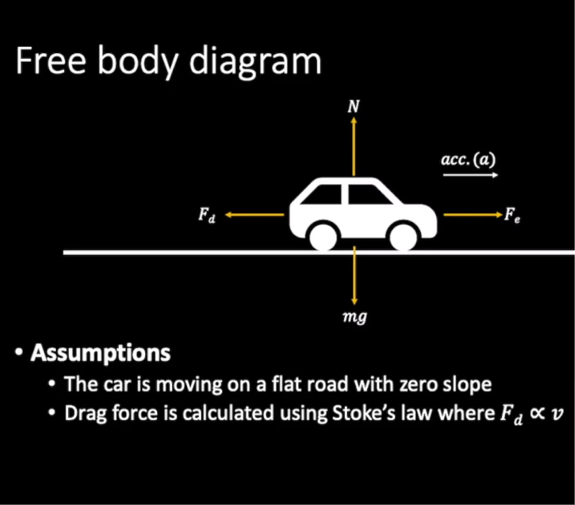
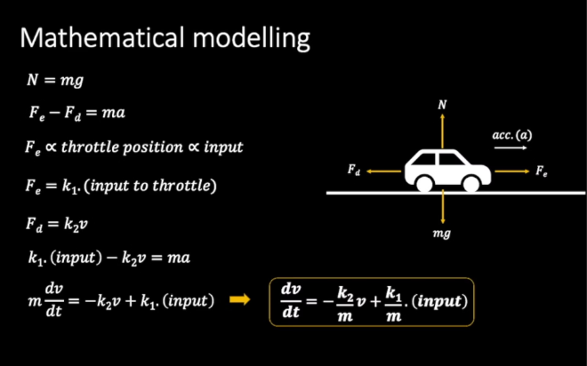

Slide 10
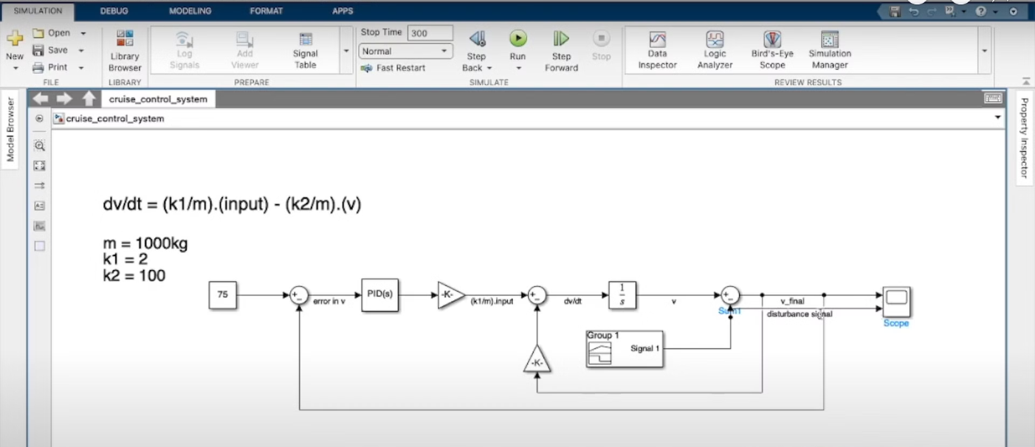
SIMULATION

Slide 11
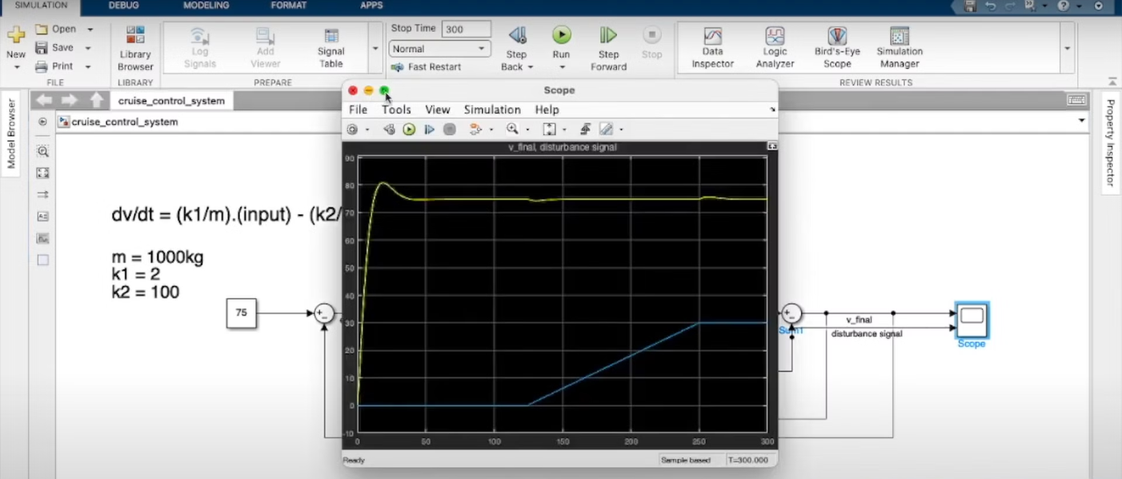
OUTPUT

Slide 12
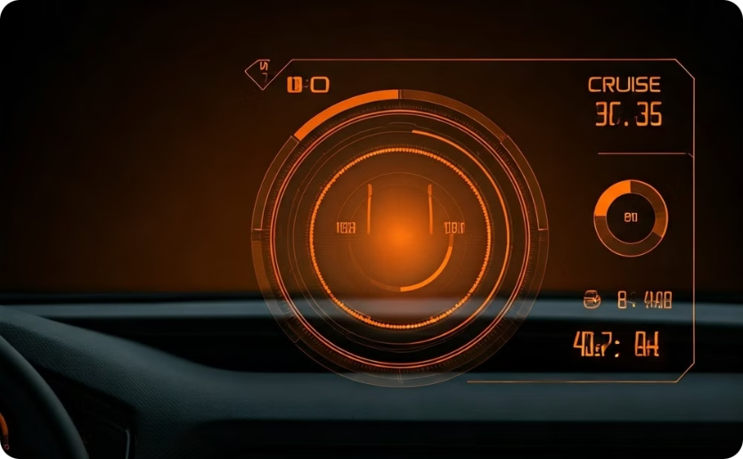
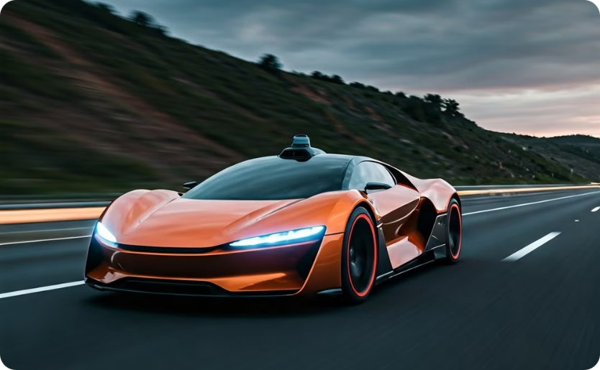
The Future of Cruise Control Technology
Advanced User Interface
Integration with Autonomous Driving
Cruise control systems will become more intuitive and user-friendly through advanced interfaces, such as heads-up displays.
Cruise control will play a crucial role in the development of autonomous driving technologies.

Slide 13

conclusion
Summary: Cruise control is an essential feature in modern vehicles, improving comfort, safety, and efficiency.
Looking Ahead: As technology advances, cruise control systems will continue to evolve toward fully autonomous driving.

Slide 14
Key References for Cruise Control Systems
SAE J1939: This standard defines the communication protocols and message formats for electronic control systems in vehicles, including cruise control.
ISO 15622: This international standard specifies the performance requirements and test procedures for adaptive cruise control systems in road vehicles.
NHTSA Regulations: The National Highway Traffic Safety Administration (NHTSA) in the United States has issued regulations governing the design and safety of cruise control systems.
OEM Technical Documents: Vehicle manufacturers provide detailed technical manuals and service information for the cruise control systems in their specific models.
Research Papers: Academic and industry publications explore the latest advancements in cruise control technology, such as sensor integration and autonomous driving applications.

